Slide 1

Go, change the world
RV College of
Engineering
Operating Systems (UNIT-2)

Slide 2
Go, change the world
Overview of Syllabus
RV College of
Engineering
Unit 1- Introduction Introduction What Operating System do, Operating System structure, Operating system Operations. System Structures Operating system services, System Calls, Types of System calls Process Management Process concept, Process scheduling, Operations on processes
Unit-2 Multithreaded programming Overview, Multicore programming, Multithreading models, Thread libraries - pthreads CPU scheduling and Process Synchronization Basic concepts, scheduling criteria, scheduling algorithms-FCFS, SJF, RR, priority, Real-time CPU scheduling
Unit 3- Process Synchronization Background, The Critical section problem, Peterson’s Solution Process Synchronization hardware, Mutex locks, Semaphores, Classic problems of synchronization
Unit 4- Main Memory Management Background, Swapping, Contiguous memory allocation, Segmentation, Paging, Structure of page table. Virtual memory Background, Demand Paging, Copy-on-write, Page replacement, Allocation of frames, Thrashing
Unit -5 File Systems File Naming, File Structure, File Types, File Access, File Attributes, File Operations, An example program using File-System calls, File-System Layout, Implementing Files

Slide 3
Go, change the world
Overview –Threads
RV College of
Engineering
Process : The program loaded into the memory and getting executed is called Process
Thread : Basic unit of CPU utilization; it comprises a thread ID, a program counter, a register set, and a stack
Threads aren’t actually allowed to exist outside a process
Process may have many threads in it
Each and every thread belongs to one single process
It shares with other threads belonging to the same process its code section, data section, and other operating-system resources, such as open files and signals.

Slide 4
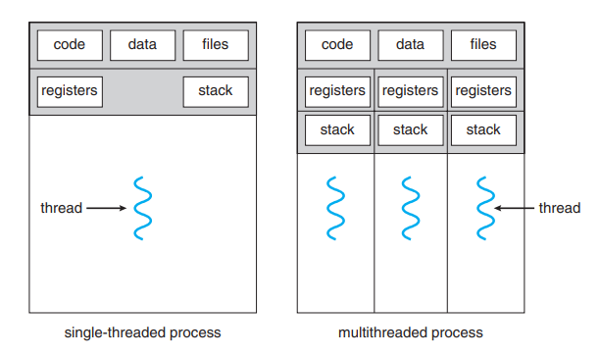
Go, change the world
RV College of
Engineering
Overview –Single and Multithreaded Processes
A traditional (or heavyweight) process has a single thread of control.
If a process has multiple threads of control, it can perform more than one task at a time.
Example
A word processor may have a thread for displaying graphics, another thread for responding to keystrokes from the user, and a third thread for performing spelling and grammar checking in the background.

Slide 5
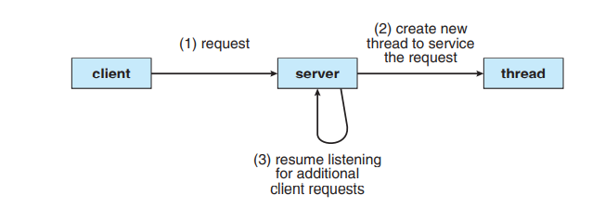
Go, change the world
Overview –Single and Multithreaded Processes
RV College of
Engineering
Example
If the web server ran as a traditional single-threaded process, it would be able to service only one client at a time, and a client might have to wait a very long time for its request to be serviced.
Two Solutions to Address this Problem :
First : Create the New traditional Process to service the request.
Second : Create the New Thread to service the request.
Process creation is time consuming and resource intensive, however. If the new process will perform the same tasks as the existing process.
More efficient to use one process that contains multiple threads
Multithreaded server architecture

Slide 6
Go, change the world
Why Do We Need Thread?
RV College of
Engineering
Creating a new thread in a current process requires significantly less time than creating a new process.
Threads can share common data without needing to communicate with each other.
When working with threads, context switching is faster.
Terminating a thread requires less time than terminating a process.

Slide 7
Go, change the world
Benefits of Threads
RV College of
Engineering
Responsiveness – May allow continued execution if part of process is blocked, this quality is useful to design especially important for user interfaces. If one thread fails, other thread will pitch in, so the user will not experience the lag.
Resource Sharing – Processes can only share resources through techniques such as shared memory and message passing. Such techniques must be explicitly arranged by the programmer. But in case of the thread they share the resources by default
Economy – Allocating memory and resources for process creation is costly,Cheaper than process creation, thread switching lower overhead than context switching.
Eg : In Solaris OS , Creating Process is 30 minutes slower compared to thread process creation.
Scalability – Threads can take advantage of multiprocessor architectures

Slide 8
Go, change the world
Multi Core Programming
RV College of
Engineering
Earlier in the history of computer design, in response to the need for more computing performance, single-CPU systems evolved into multi-CPU systems.
Recent Trend - in system design is to place multiple computing cores on a single chip.
CPU Chips having more than one core- such systems are called as Multi Core Systems
Each core appears as a separate processor to the operating system.
Consider an application with four threads.
System with a single computing core- Processing core is capable of executing only one thread at a time.
System with multiple cores - Threads can run in parallel, because the system can assign a separate thread to each core.

Slide 9
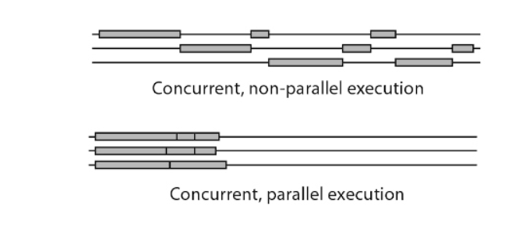
Go, change the world
Multi Core Programming
RV College of
Engineering
Concurrency is the task of running and managing the multiple computations at the same time.
Parallelism is the task of running multiple computations simultaneously.

Slide 10
Go, change the world
Multi Core Programming - Programming Challenges
RV College of
Engineering
Multicore or multiprocessor systems putting pressure on programmers, challenges include:
Dividing activities : Involves examining applications to find areas that can be divided into separate, concurrent tasks.
Balance : programmers must also ensure that the tasks perform equal work of equal value. In some instances, a certain task may not contribute as much value to the overall process as other tasks.
Data splitting : Just as applications are divided into separate tasks, the data accessed and manipulated by the tasks must be divided to run on separate cores
Data dependency: one task depends on data from another, programmers must ensure that the execution of the tasks is synchronized to accommodate the data dependency
Testing and debugging: Testing and debugging such concurrent programs is inherently more difficult than testing and debugging single-threaded applications

Slide 11
Go, change the world
Multithreading Models
RV College of
Engineering
Many-to-One
One-to-One
Many-to-Many

Slide 12
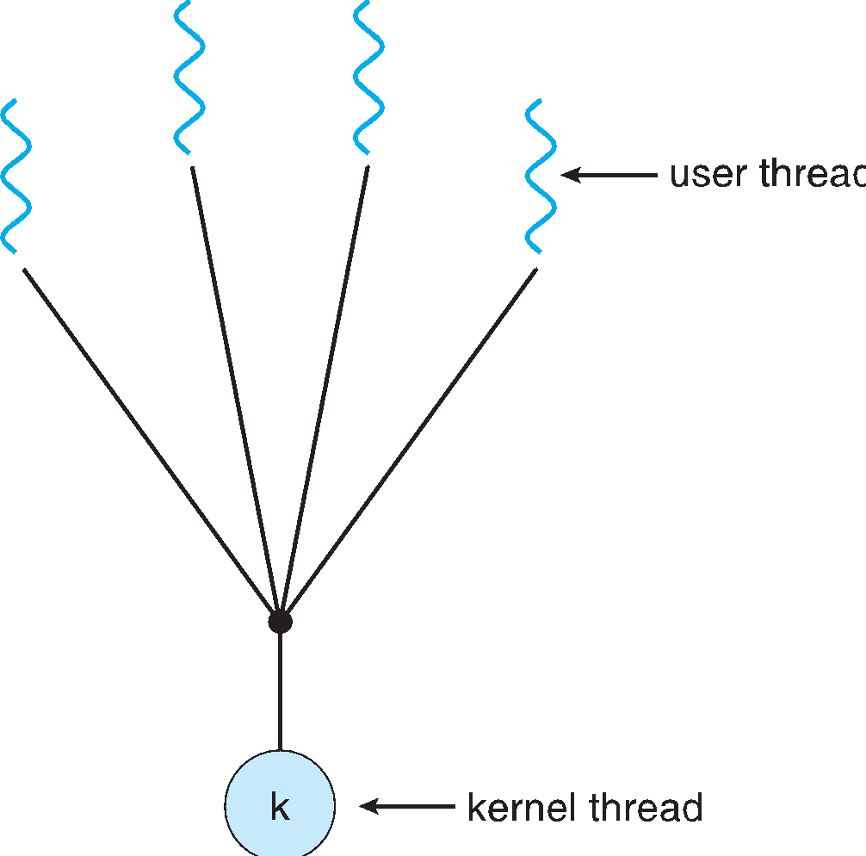
Go, change the world
Many-to-One
RV College of
Engineering
Many user-level threads mapped to single kernel thread
One thread blocking causes all to block
Multiple threads may not run in parallel on multicore system because only one may be in kernel at a time (It doesn’t implement the multiprocessor )
Few systems currently use this model
Examples:
Solaris Green Threads
GNU Portable Threads

Slide 13
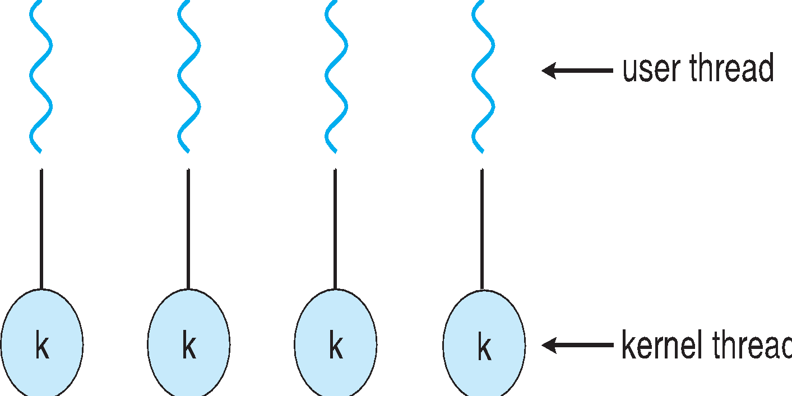
Go, change the world
One-to-One
RV College of
Engineering
Each user-level thread maps to kernel thread
Creating a user-level thread creates a kernel thread
More concurrency than many-to-one
Number of threads per process sometimes restricted due to overhead
Examples
Windows
Linux
Solaris 9 and later

Slide 14
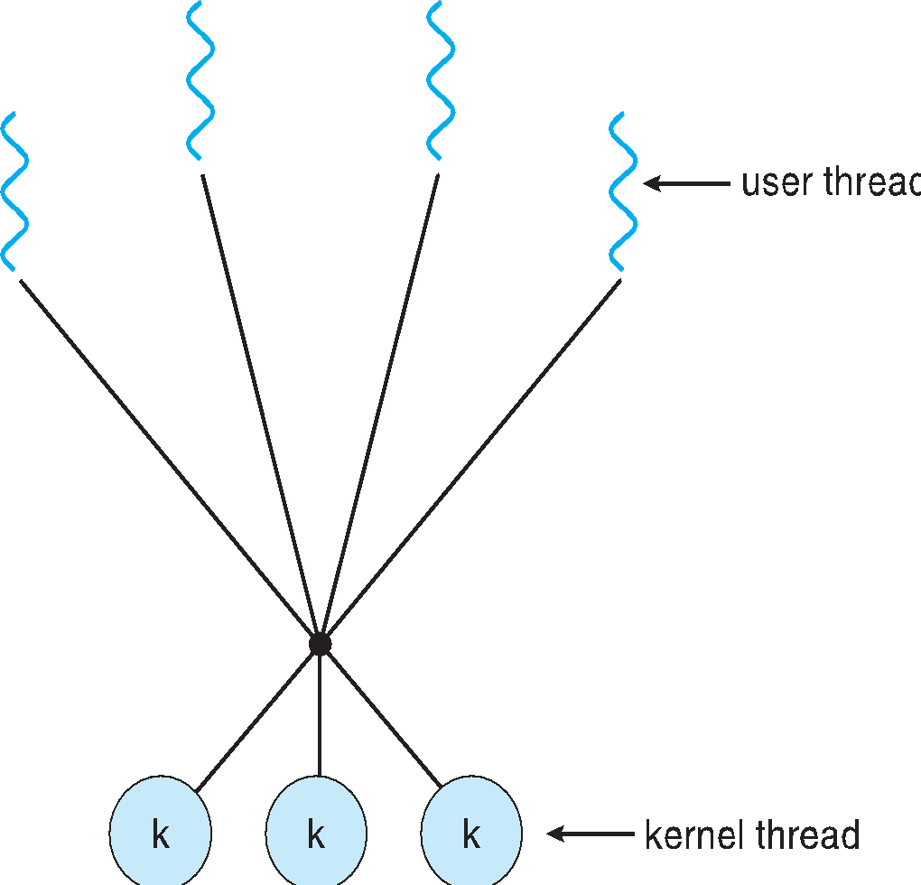
Go, change the world
Many-to-Many Model
RV College of
Engineering
Allows many user level threads to be mapped to many kernel threads
Allows the operating system to create a sufficient number of kernel threads

Slide 15
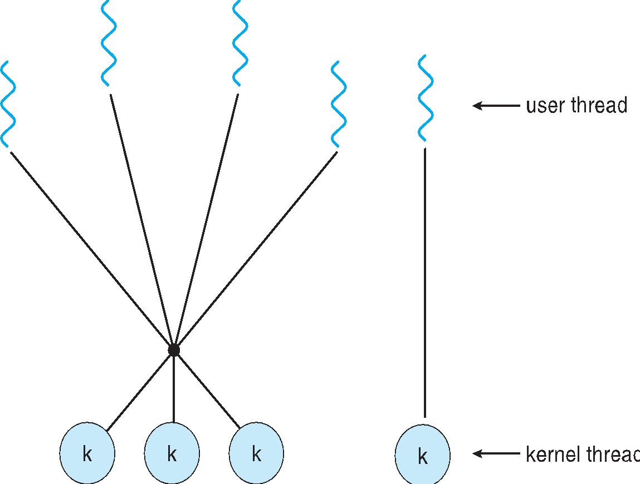
Go, change the world
Two-level Model
RV College of
Engineering
Similar to M:M, except that it allows a user thread to be bound to kernel thread
Examples
IRIX
HP-UX
Tru64 UNIX
Solaris 8 and earlier

Slide 16
Go, change the world
Two-level Model
RV College of
Engineering
Similar to M:M, except that it allows a user thread to be bound to kernel thread
Examples
IRIX
HP-UX
Tru64 UNIX
Solaris 8 and earlier

Slide 17
Go, change the world
Types of Parallelism
RV College of
Engineering
Data parallelism
Focuses on distributing subsets of the same data across multiple computing cores and performing the same operation on each core.
Example:
Summing the contents of an array of size N.
thread 1, running on core 1, could sum the elements [0] . . . [N/2 − 1] while thread B, running on core 1, could sum the elements [N/2] . . . [N − 1].
Task parallelism
It involves distributing of the Tasks(Threads) across the multiple computing cores.
Each thread is performing a unique operation on the data.

Slide 18
Go, change the world
Thread Libraries
RV College of
Engineering
A thread library provides the programmer with an API for creating and managing threads.
There are two primary ways of implementing a thread library.
Library entirely in user space
The first approach is to provide a library entirely in user space with no kernel support.
All code and data structures for the library exist in user space.
This means that invoking a function in the library results in a local function call in user space and not a system call.
Library entirely in Kernel space
Kernel-level library supported directly by the operating system.
In this case, code and data structures for the library exist in kernel space.
Invoking a function in the API for the library typically results in a system call to the kernel

Slide 19
Go, change the world
Pthreads
RV College of
Engineering
Pthreads refers to the POSIX standard (IEEE 1003.1c) defining an API for thread creation and synchronization.
POSIX
The Portable Operating System Interface (POSIX) is a family of standards specified by the IEEE Computer Society for maintaining compatibility between operating systems.
This is a specification for thread behaviour, not an implementation.
API specifies behavior of the thread library, implementation is up to developer
Common in UNIX operating systems (Solaris, Linux, Mac OS X)

Slide 20
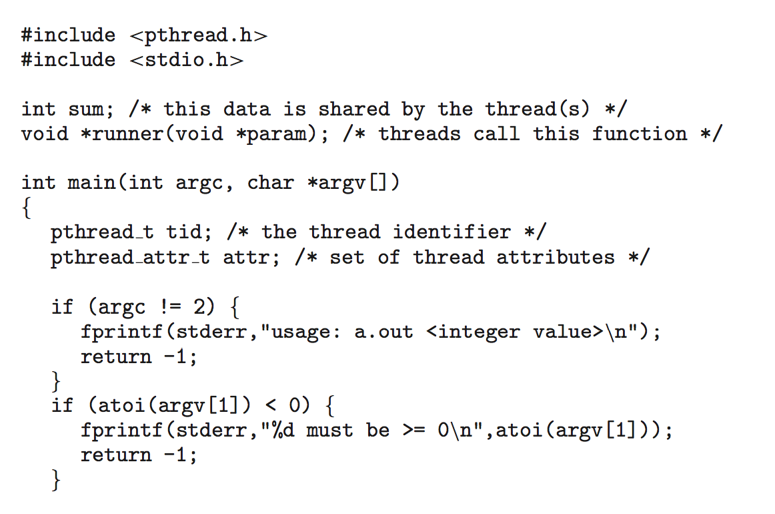
Go, change the world
Pthreads – Example
RV College of
Engineering
Thread Program to calculate the sum of first N Numbers
Include the Libraries
Define the Global Variable Sum
Define the Pointer Runner which access Void Pointer
Void*parameter : Function Declaration
Define the command line arguments
Argc- Argument Counts (Int Type)
Argv – Stores the argument we have passed
Eg : Let the file name is sum.c, then argv[0]
contains the file name and argv[1] contains the N number
Tid : Thread Identification Number
Attr_t == Data Type and attr == Is the Variable (Using these
variables, we can give some new attributes to the thread)

Slide 21
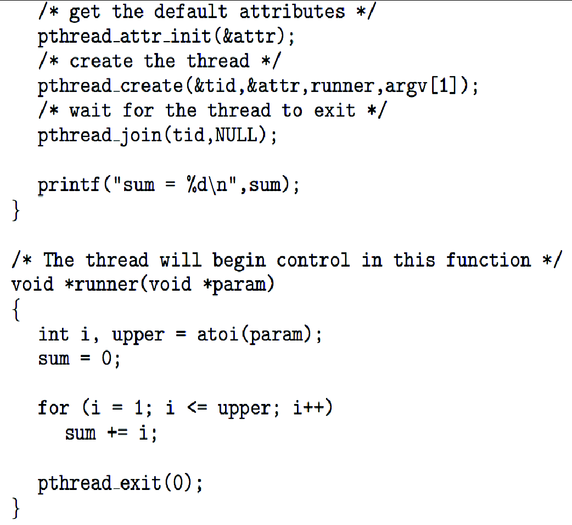
Go, change the world
Pthreads – Example
RV College of
Engineering
Init – Initialization and & attr is used to store the
address of the variable.
Creation of Threads : It contains four arguments (thread
identification number, attributes, function and argument)
Join : Blocks the main function, until the runner
function executes
(Parent thread will wait for function to terminate, and
this is done by Join function)
The atoi() function converts a character string to an integer value.
The summation thread will terminate when it calls
the function pthread exit().

Slide 22
Go, change the world
CPU scheduling and Process Synchronization
RV College of
Engineering
CPU scheduling is the basis of Multiprogrammed operating systems.
Goal : Computer more productive
Basics
In a single-processor system, only one process can run at a time.
The objective of multiprogramming is to have some process running at all times, to maximize CPU utilization.
Several processes are kept in memory at one time

Slide 23
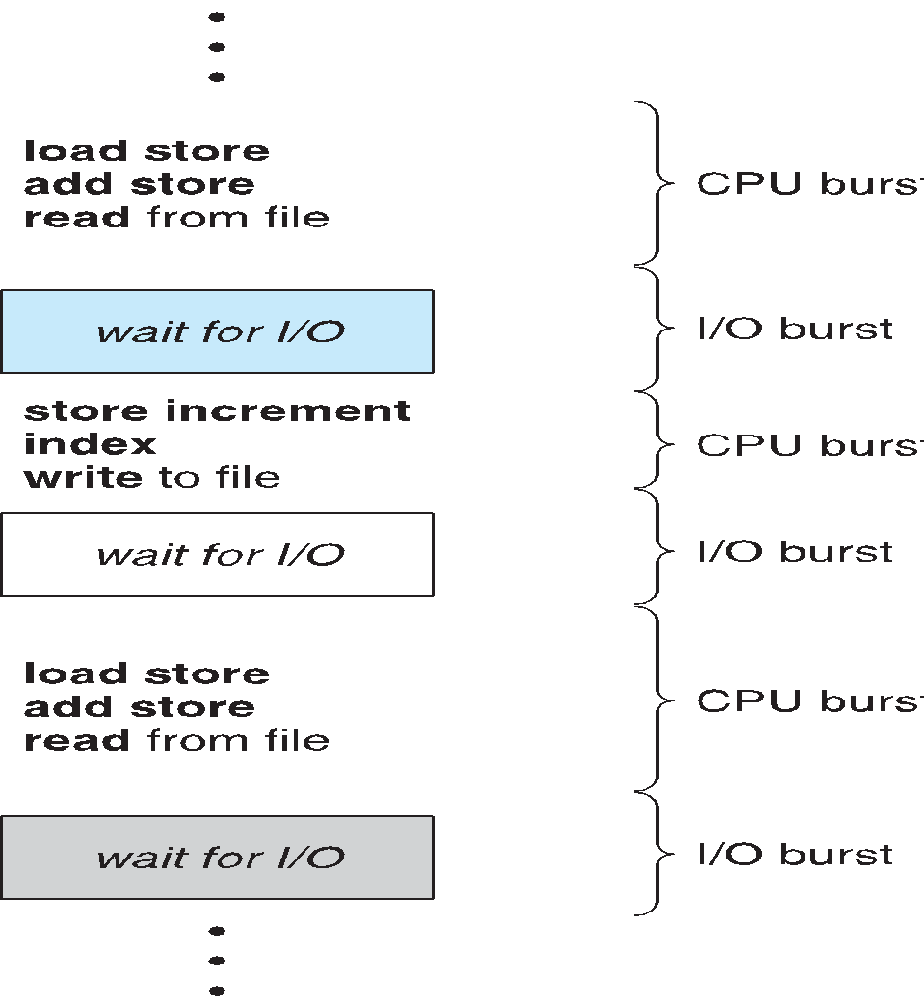
Go, change the world
CPU –I/O Burst Cycle
RV College of
Engineering
Process Execution consist of two states i.e. in CPU execution and I/O wait
CPU Burst : Time in which the process is in CPU execution
I/O Burst : Time in which the process is in I/O wait

Slide 24
Go, change the world
Scheduling Criteria
RV College of
Engineering
CPU utilization – Keep the CPU as busy as possible. (In lightly loaded system,
Throughput – (Measure of the work done by the CPU) i.e Number of the of processes that complete their execution per time unit.
Turnaround time – amount of total time to execute a particular process (Turnaround time is the sum of the periods spent waiting to get into memory, waiting in the ready queue, executing on the CPU, and doing I/O)
Waiting time – Amount of time a process has been waiting in the ready queue.
Response time – Amount of time it takes from when a request was submitted until the first response is produced, not output (for time-sharing environment).

Slide 25
Go, change the world
Scheduling Algorithm Optimization Criteria
RV College of
Engineering
Max CPU utilization
Max throughput
Min turnaround time
Min waiting time
Min response time

Slide 26
Go, change the world
RV College of
Engineering
First- Come, First-Served (FCFS) Scheduling
Simplest CPU-scheduling algorithm
The process that requests the CPU first is allocated the CPU first.
It is easily implemented by FIFO queue.
When a process enters the ready queue, its PCB is linked onto the tail of the queue. When the CPU is free, it is allocated to the process at the head of the queue.
Drawback : the average waiting time under the FCFS policy is often quite long

Slide 27
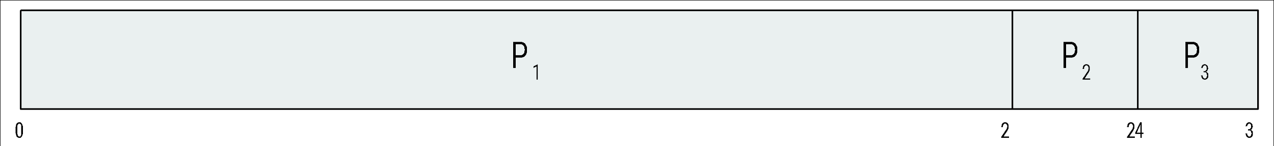
Go, change the world
RV College of
Engineering
First- Come, First-Served (FCFS) Scheduling
Process Burst Time
P₁ 24
P₂ 3
P₃ 3
Suppose that the processes arrive in the order: P₁ , P₂ , P₃ The Gantt Chart for the schedule is:
Waiting time for P₁ = 0; P₂ = 24; P₃ = 27
Average waiting time: (0 + 24 + 27)/3 = 17

Slide 28
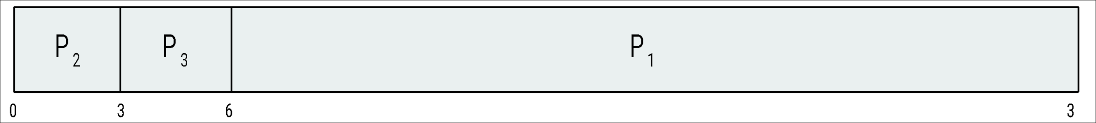
Go, change the world
RV College of
Engineering
First- Come, First-Served (FCFS) Scheduling
Suppose that the processes arrive in the order:
P₂ , P₃ , P₁
The Gantt chart for the schedule is:
Waiting time for P₁ = 6; P₂ = 0; P₃ = 3
Average waiting time: (6 + 0 + 3)/3 = 3
Much better than previous case
Convoy effect - All the other processes wait for the one big process to get off the CPU

Slide 29
Go, change the world
RV College of
Engineering
First- Come, First-Served (FCFS) Scheduling
FCFS is the Non Preemptive Scheduling.
In FCFS Scheduling , once the CPU has allocated the process, that process keeps
the CPU until its executed completely.
Drawback : This will not work in Time Sharing Systems, and doesn’t support the
Context Switch

Slide 30
Go, change the world
FCFS Problem
RV College of
Engineering
Process ID | Arrival Time | Burst Time
P1 | 4 | 5
P2 | 6 | 4
P3 | 0 | 3
P4 | 6 | 2
P5 | 5 | 4
Calculate the Average Waiting Time and Turn around time
Turn Around Time == Completion time – Arrival Time
Waiting Time == Turn around time - Burst Time
Note : If the two process have same arrival time, Lowest Process id will be having the Highest priority

Slide 31
Go, change the world
FCFS Problem
RV College of
Engineering
Process ID | Arrival Time | Burst Time | Turn around Time | Waiting Time
P1 | 4 | 5 | 5 | 0
P2 | 6 | 4 | 11 | 7
P3 | 0 | 3 | 3 | 0
P4 | 6 | 2 | 13 | 11
P5 | 5 | 4 | 8 | 4
P3
Idle
P1
P5
P2
P4
0
3
4
9
13
17
19
Average Turn around time = (Total Turn Around Time )/ (Total Number of Process) =(40/5)= 8 units
Average Waiting Time == = (Total Waiting Time )/ (Total Number of Process) = 22/5 = 4.4 units

Slide 32
Go, change the world
FCFS Problem
RV College of
Engineering
Process ID | Arrival Time | Burst Time
P1 | 0 | 3
P2 | 1 | 2
P3 | 2 | 1
P4 | 3 | 4
P5 | 4 | 5
P6 | 5 | 2
Calculate the Efficiency of the algorithm, by applying the FCFS Process and consider 1 unit
of overhead in scheduling the process

Slide 33
Go, change the world
Shortest JoB First (SJF)
RV College of
Engineering
When the CPU is available, it is assigned to the process that has the smallest next CPU burst
If the next CPU bursts of two processes are the same, FCFS scheduling is used to break the tie
SJF Algorithm is Pre-emptive or Non Premptive (If the two process have same burst time, Lowest Process
id will be having the Highest priority)
More appropriate term for this scheduling method would be the shortest-next CPU-burst algorithm,
because scheduling depends on the length of the next CPU burst of a process rather than rather than its total length

Slide 34
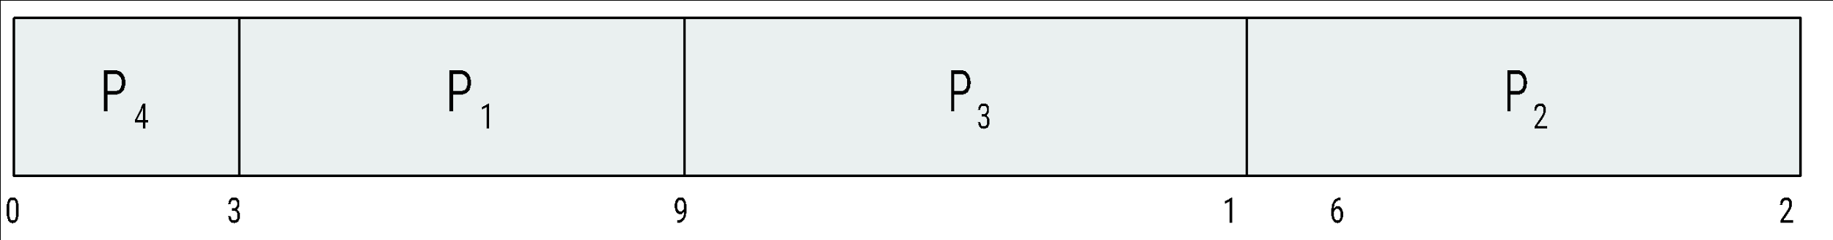
Go, change the world
Shortest JoB First (SJF)
RV College of
Engineering
ProcessArriva l TimeBurst Time
P₁ 0.0 6
P₂ 2.0 8
P₃ 4.0 7
P₄ 5.0 3
SJF scheduling chart
Average waiting time = (3 + 16 + 9 + 0) / 4 = 7
Apply FCFS and compare the average waiting time

Slide 35
Go, change the world
RV College of
Engineering
Shortest JoB First (SJF)- Example -Premptive
ProcessArriva l TimeBurst Time
P₁ 0.0 6
P₂ 2.0 8
P₃ 4.0 7
P₄ 5.0 3
SJF scheduling chart
Average waiting time = (3 + 16 + 9 + 0) / 4 = 7
Apply FCFS and compare the average waiting time

Slide 36
Go, change the world
Shortest JoB First (SJF)
RV College of
Engineering
Process ID | Arrival Time | Burst Time
P1 | 0 | 8
P2 | 1 | 4
P3 | 2 | 9
P4 | 3 | 5
P
P
P
P
P
1
2
4
1
3
0
1
5
1
0
2
17
6
Waiting Time = Total waiting time- No of Milliseconds Process executed – Arrival time
P1 = 10-01-00 =9
P2 = 1-0-1 = 0
P3 = 17-0-2 = 15
P4 = 5-0-3 = 2
Average waiting time = 26/4 = 6.5ms
SJF Premptive is called as Shortest Remaining time first scheduling

Slide 37
Go, change the world
Shortest JoB First (SJF)
RV College of
Engineering
Consider the following process with the arrival time and length of CPU burst given in milliseconds. The scheduling algorithm is Premptive SJF. Calculate average Turn around time
Process ID | Arrival Time | Burst Time
P1 | 0 | 10
P2 | 3 | 6
P3 | 7 | 1
P4 | 8 | 3
P
P
P
P
P4
P1
1
2
3
2
0
3
8
10
13
2
7
0
Turn Around Time = Completion Time – Arrival Time
P1 = 20-0 =20
P2 = 10-3 = 7
P3 = 8-7 = 1
P4 = 13-8 = 5
Average waiting time = 33/4 = 8.2ms
Calculate the Average waiting time

Slide 38
Go, change the world
Shortest JoB First (SJF)
RV College of
Engineering
Consider the following process with the arrival time and length of CPU burst given in milliseconds. The scheduling algorithm is Premptive SJF. Calculate average Turn around time
Process ID | Arrival Time | Burst Time
P1 | 0 | 12
P2 | 2 | 4
P3 | 3 | 6
P4 | 8 | 5
P
P
P
P
P1
1
2
3
4
0
2
6
12
17
27
Calculate the Average waiting time and Turn around time

Slide 39
Go, change the world
Priority Scheduling
RV College of
Engineering
The SJF algorithm is a special case of the general priority-scheduling algorithm
A priority is associated with each process, and the CPUis allocated to the process with the highest priority.
(smallest integer ≡ highest priority).
Equal-priority processes are scheduled in FCFS order.
SJF is priority scheduling where priority is the inverse of predicted next CPU burst time. (Larger the CPU
Burst time, lower the priority and vice versa).
Priority Scheduling algorithm is Premptive or Non Premptive

Slide 40
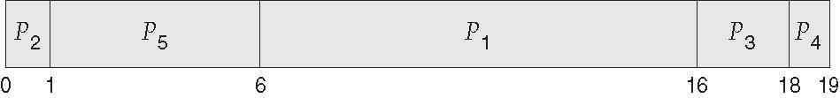
Go, change the world
Priority Scheduling
RV College of
Engineering
As an example, consider the following set of processes, assumed to have arrived at time 0 in the order P1, P2, ···, P5, with the length of the CPU burst given in milliseconds:
ProcessA arri Burst Time Priority
P₁ 10 3
P₂ 1 1
P₃ 2 4
P₄ 1 5
P₅ 5 2
Priority scheduling Gantt Chart
Average waiting time = 8.2 msec

Slide 41
Go, change the world
Priority Scheduling
RV College of
Engineering
Major problem with priority scheduling algorithms is indefinite blocking, or starvation.
A process that is ready to run but waiting for the CPU can be considered blocked
Problem ≡ Starvation – low priority processes may never execute
Solution ≡ Aging – as time progresses increase the priority of the process

Slide 42
Go, change the world
RV College of
Engineering
Priority Scheduling Solved Pbm-1(Gate-2017)
Process ID | Arrival Time | Burst Time | Priority
P1 | 0 | 11 | 2
P2 | 5 | 28 | 0
P3 | 12 | 2 | 3
P4 | 2 | 10 | 1
P5 | 9 | 16 | 4
Consider the Set of the Process and find the average waiting time by applying Premptive Priority Scheduling
Ans:
Waiting Time = Total waiting time- No of Milliseconds Process executed – Arrival time
P1 = 40-02-00 =38
P2 = 5-0-5= 0
P3 = 49-0-12 = 37
P4 = 33-3-2= 28
P5 = 51-0-9 = 42
Average waiting time = 145/5 = 29ms
P
P
P
P
P1
P3
P5
1
4
2
4
40
49
51
67
0
2
5
33

Slide 43
Go, change the world
RV College of
Engineering
Priority Scheduling Solved Pbm-2
Process ID | Arrival Time | Burst Time | Priority
P1 | 0 | 4 | 2
P2 | 1 | 3 | 3
P3 | 2 | 1 | 4
P4 | 3 | 5 | 5
P5 | 4 | 2 | 5
Consider the Set of the Process and find the average waiting time by applying Non Premptive Priority Scheduling
(Note: Higher Number Represents Higher Priority )
P2
12
15

Slide 44
Go, change the world
RV College of
Engineering
Priority Scheduling Solved Pbm-2
Process ID | Arrival Time | Burst Time | Priority
P1 | 0 | 4 | 2
P2 | 1 | 3 | 3
P3 | 2 | 1 | 4
P4 | 3 | 5 | 5
P5 | 4 | 2 | 5
Consider the Set of the Process and find the average waiting time by applying Non Premptive Priority Scheduling
(Note: Higher Number Represents Higher Priority )
Ans:
Turn Around Time == Completion time – Arrival Time
P1= 4-0 = 4 , P2=15-1 = 14, P3 = 12-2 = 10, P4 = 9-3 = 6, P5 = 11-4 = 7
Waiting Time == Turn around time - Burst Time
P1 = 4-4 = 0, P2= 14-3 = 11,P3 = 9,P4 = 1, P5 = 5
P
P
P
P
P2
1
4
5
3
0
4
9
11
12
15

Slide 45
Go, change the world
RV College of
Engineering
Round Robin (RR)
The round-robin (RR) scheduling algorithm is designed especially for time sharing systems.
It is similar to FCFS scheduling, but pre-emption is added to enable the system to switch between processes.
A small unit of time, called a time quantum or time slice, is defined. (A time quantum is generally from 10 to 100 milliseconds in length)
The CPU scheduler goes around the ready queue, allocating the CPU to each process for a time interval of up to 1 time quantum.
The CPU scheduler picks the first process from the ready queue, sets a timer to interrupt after 1 time quantum, and dispatches the process.
The process may have a CPU burst of less than 1 time quantum. In this case, the process itself will release the CPU voluntarily. The scheduler will then proceed to the next process in the ready queue.
If the CPU burst of the currently running process is longer than 1 time quantum, the timer will go off and will cause an interrupt to the operating system. A context switch will be executed, and the process will be put at the tail of the ready queue.
The CPU scheduler will then select the next process in the ready queue.

Slide 46
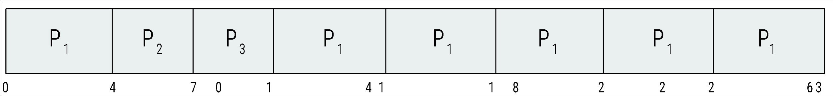
Go, change the world
RV College of
Engineering
Example of RR with Time Quantum = 4
Process Burst Time
P₁ 24
P₂ 3
P₃ 3
The Gantt chart is:
Turn Around Time == Completion time – Arrival Time
P1= 30-0 = 30, P2 = 7,P3 = 10
Waiting Time = Turn Around time – Burst Time
P1= 6 P2 =4 P3 = 7

Slide 47
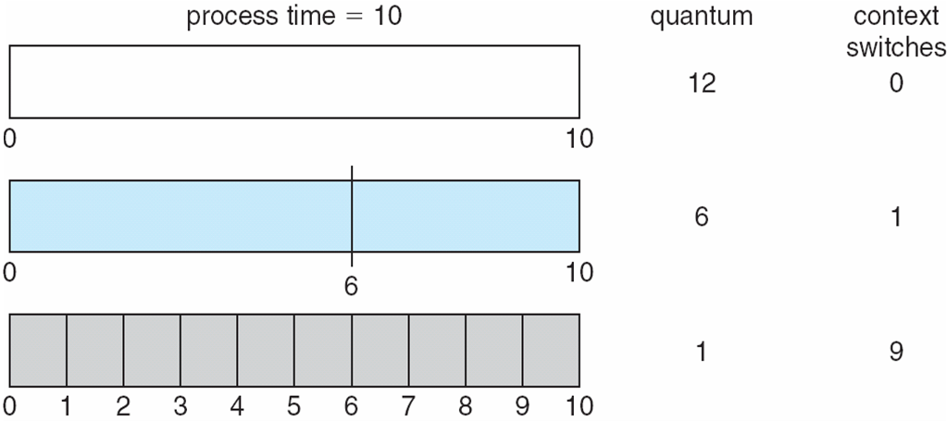
Go, change the world
RV College of
Engineering
Round Robin Continued
The performance of the RR algorithm depends heavily on the size of the time quantum. At one extreme, if the time quantum is extremely large, the RR policy is the same as the FCFS policy.
If the time quantum is extremely small (say, 1 millisecond), the RR approach can result in a large number of context switches
A rule of thumb is that 80 percent of the CPU bursts should be shorter than the time quantum.
Typically, higher average turnaround than SJF, but better response

Slide 48
Go, change the world
RV College of
Engineering
Round Robin Continued
The performance of the RR algorithm depends heavily on the size of the time quantum. At one extreme, if the time quantum is extremely large, the RR policy is the same as the FCFS policy.
If the time quantum is extremely small (say, 1 millisecond), the RR approach can result in a large number of context switches
A rule of thumb is that 80 percent of the CPU bursts should be shorter than the time quantum.
Typically, higher average turnaround than SJF, but better response

Slide 49
Go, change the world
RV College of
Engineering
Round Robin Scheduling - Problem
Process ID | Arrival Time | Burst Time
P1 | 0 | 5
P2 | 1 | 3
P3 | 2 | 1
P4 | 3 | 2
P5 | 4 | 3
Consider the Set of the Process and find the average waiting time and turn around time by applying Round Robin Scheduling, consider the time quantum of 2ms
Ans:
Turn Around Time == Completion time – Arrival Time
P1= 14-0 = 14 , P2=12-1 = 13, P3 = 5-2 = 3, P4 = 7-3 = 4, P5 = 13-4 = 9
Waiting Time == Turn around time - Burst Time
P1 = 9 , P2= 10,P3 = 2,P4 = 2, P5 = 6
P
P
P
P
P5
P1
P2
P5
P1
1
2
3
4
0
2
5
7
9
11
12
13
14
4

Slide 50
Go, change the world
Round Robin Scheduling – Problem - 2-GATE 2019
RV College of
Engineering
Process ID | Arrival Time | Burst Time
P1 | 0 | 5
P2 | 1 | 3
P3 | 2 | 1
P4 | 3 | 2
P5 | 4 | 3
Consider the Set of the Process and find the average waiting time and turn around time by applying Round Robin Scheduling, consider the time quantum of 2ms
Ans:
Just Check whether the gannt chart given below is correct or wrong
P
P
P
P
P5
P1
P2
P5
P1
1
2
3
4
0
2
5
7
9
11
12
13
14
4

Slide 51
Go, change the world
Round Robin Scheduling – Problem - 2-GATE 2019
RV College of
Engineering
Process ID | Arrival Time | Burst Time
P1 | 0 | 5
P2 | 1 | 3
P3 | 2 | 1
P4 | 3 | 2
P5 | 4 | 3
Consider the Set of the Process and find the average waiting time and turn around time by applying Round Robin Scheduling, consider the time quantum of 2ms
Ans:
The gannt chart given in the last slide is wrong, the correct one is below
Turn Around Time == Completion time – Arrival Time
P1= 13-0 = 13 , P2=12-1 = 11, P3 = 5-2 = 3, P4 = 9-3 = 6, P5 = 14-4 = 10
Waiting Time == Turn around time - Burst Time
P1 = 8 , P2= 8,P3 = 2,P4 = 4, P5 = 7
P
P
P
P
P4
P5
P2
P1
P5
1
2
3
1
0
2
5
7
9
11
12
13
14
4

Slide 52
Go, change the world
RV College of
Engineering
Round Robin Scheduling – Problem - 2
Oms – P1
1ms – P2 has arrived
2ms – P3 has arrived & P1 shifted to P2
3ms – P4 arrived
4ms – P5 has arrived & P2-P3
5ms – P3 executes & P3-P1
6ms – P1 is executing
7ms – P1 –P4
8ms = P4 is executing
9ms = P4 finishes --- P5
10ms = P5 is executing
11ms = P5—P2
12ms – P2 finishes
13ms =P1 finishes
14ms= P5 finishes
Process ID | Arrival Time | Burst Time
P1 | 0 | 5
P2 | 1 | 3
P3 | 2 | 1
P4 | 3 | 2
P5 | 4 | 3
P
P
P
P
P4
P5
P2
P1
P5
1
2
3
1
0
2
5
7
9
11
12
13
14
4

Slide 53
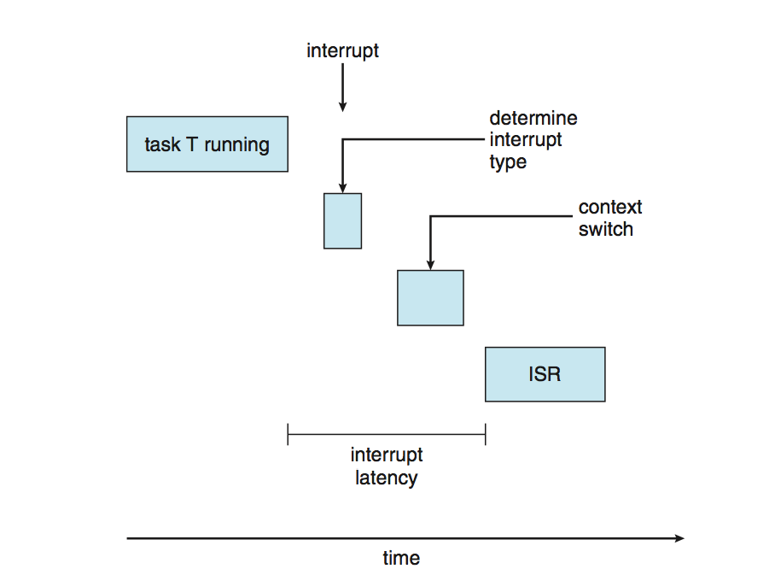
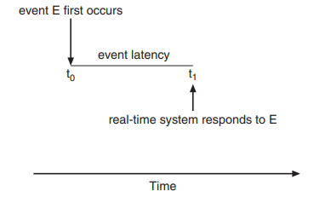
Go, change the world
RV College of
Engineering
Real-Time CPU Scheduling
Soft real-time systems – no guarantee as to when critical real-time process will be scheduled, They guarantee only that the process will be given preference over noncritical processes
Hard real-time systems – task must be serviced by its deadline,
service after the deadline has expired is the same as no service at all.
as the amount of time that elapses from when an event occurs to when it is serviced –Event Latency
Two types of latencies affect performance
Interrupt latency – refers to the period of time from the arrival of an interrupt at the CPU to the start of the routine that services the interrupt(operating systems to minimize interrupt latency to ensure that real-time tasks receive immediate attention)

Slide 54
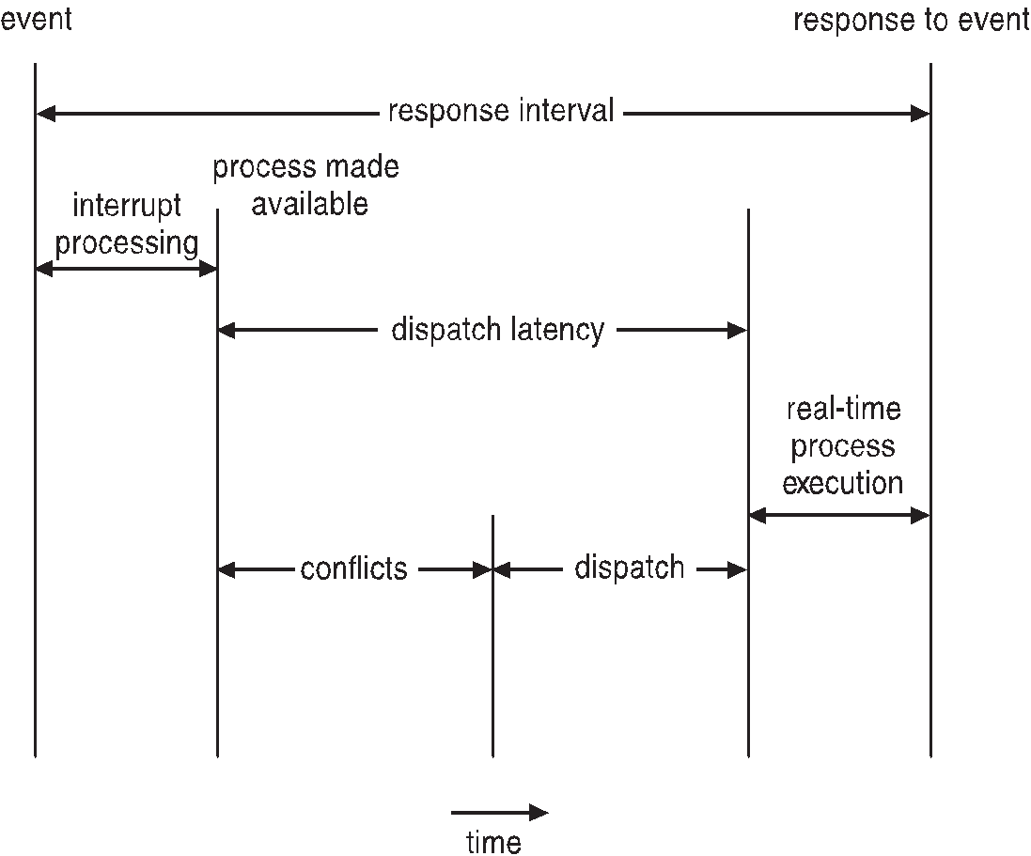
Go, change the world
RV College of
Engineering
Real-Time CPU Scheduling
Conflict phase of dispatch latency:
Preemption of any process running in kernel mode
Release by low-priority process of resources needed by high-priority processes
Dispatch latency – time for schedule to take current process off CPU and switch to another

